Slide 1


By - Bradd Martin, Timothy Hauser, Samir Ghigha, Neeraj Sharma

Slide 2

Business Situation
◦The business is family owned and has been in the same location since 1995. A husband and wife takes care of most of the duties in the store but sometimes has a few other people come in and work for them. They originally opened as a restaurant and a grocery store. In the last year due to COVID-19 they have shut down dine in eating and are mostly focusing on the grocery store aspect.

Slide 4
Interview Questions
When we visited the store to interview the owner, we came with a panel of questions, these questions included things such as:
What are the current systems you have in place?
What changes need to be made to those?
Are there any new systems you would be interested in?
After gaining some knowledge about the systems we asked about the information they would be storing.
We asked if they wanted to track any of the following:
Sales?
Profit?
Transactions?

Slide 5
Interview Report/Analysis
We learned from the interview that there was no formal system in place.
All the information was stored by memory in the owner's head.
Knowing this information combined with the lack of technical knowledge from the owner, we were able to design the system in the best way that we saw fit.

Slide 6
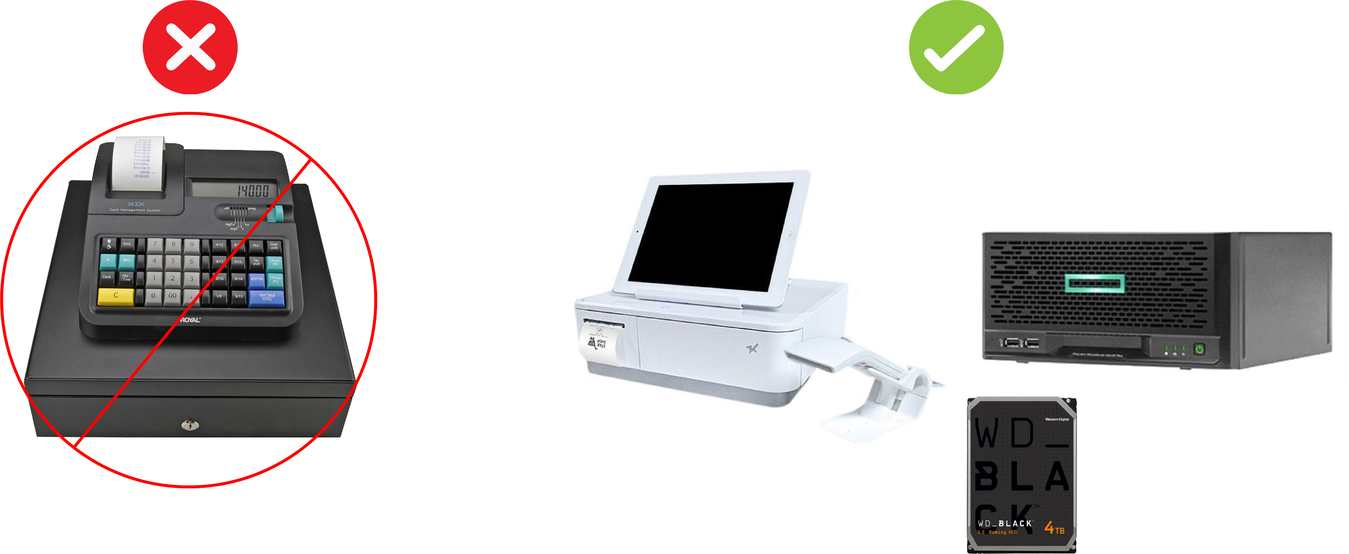
Project Scope
The main goal of this project is to help the store by combining all of its functions into one application.
This will help the store by making it easier to sell things and it will give them access to stored data and transaction history.

Slide 7

Project Scope
The deliverables for this product would include
Cash Register (Desktop Application)
Inventory Adjustment System (Desktop Application)
Employee Scheduler (Desktop Application)
Schedule Viewer (Mobile Application)

Slide 8




Project Scope
The cash register records transactions and sends them to database.
The inventory system speeds up processes, identifies slow-moving or obsolete items, and even helps evaluate suppliers.
Employee Scheduler Application creates, edits and deletes employee schedules.
The mobile application allows employees to view their schedule

Slide 9
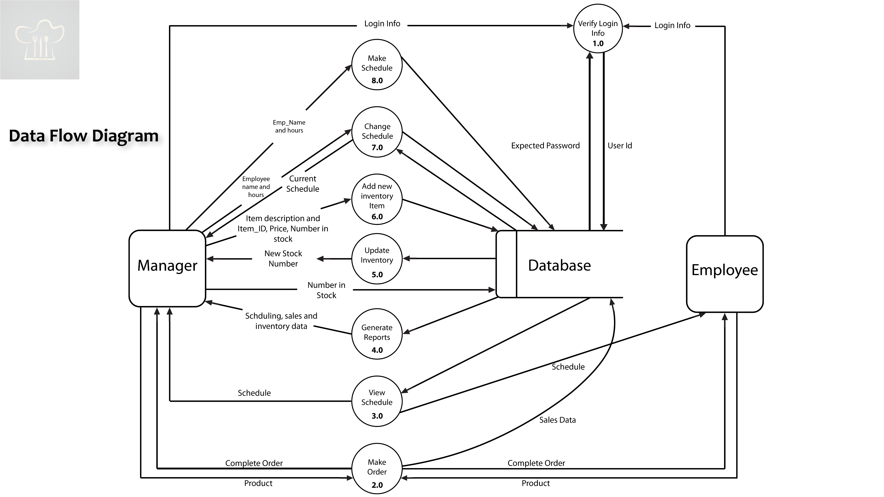

Slide 10
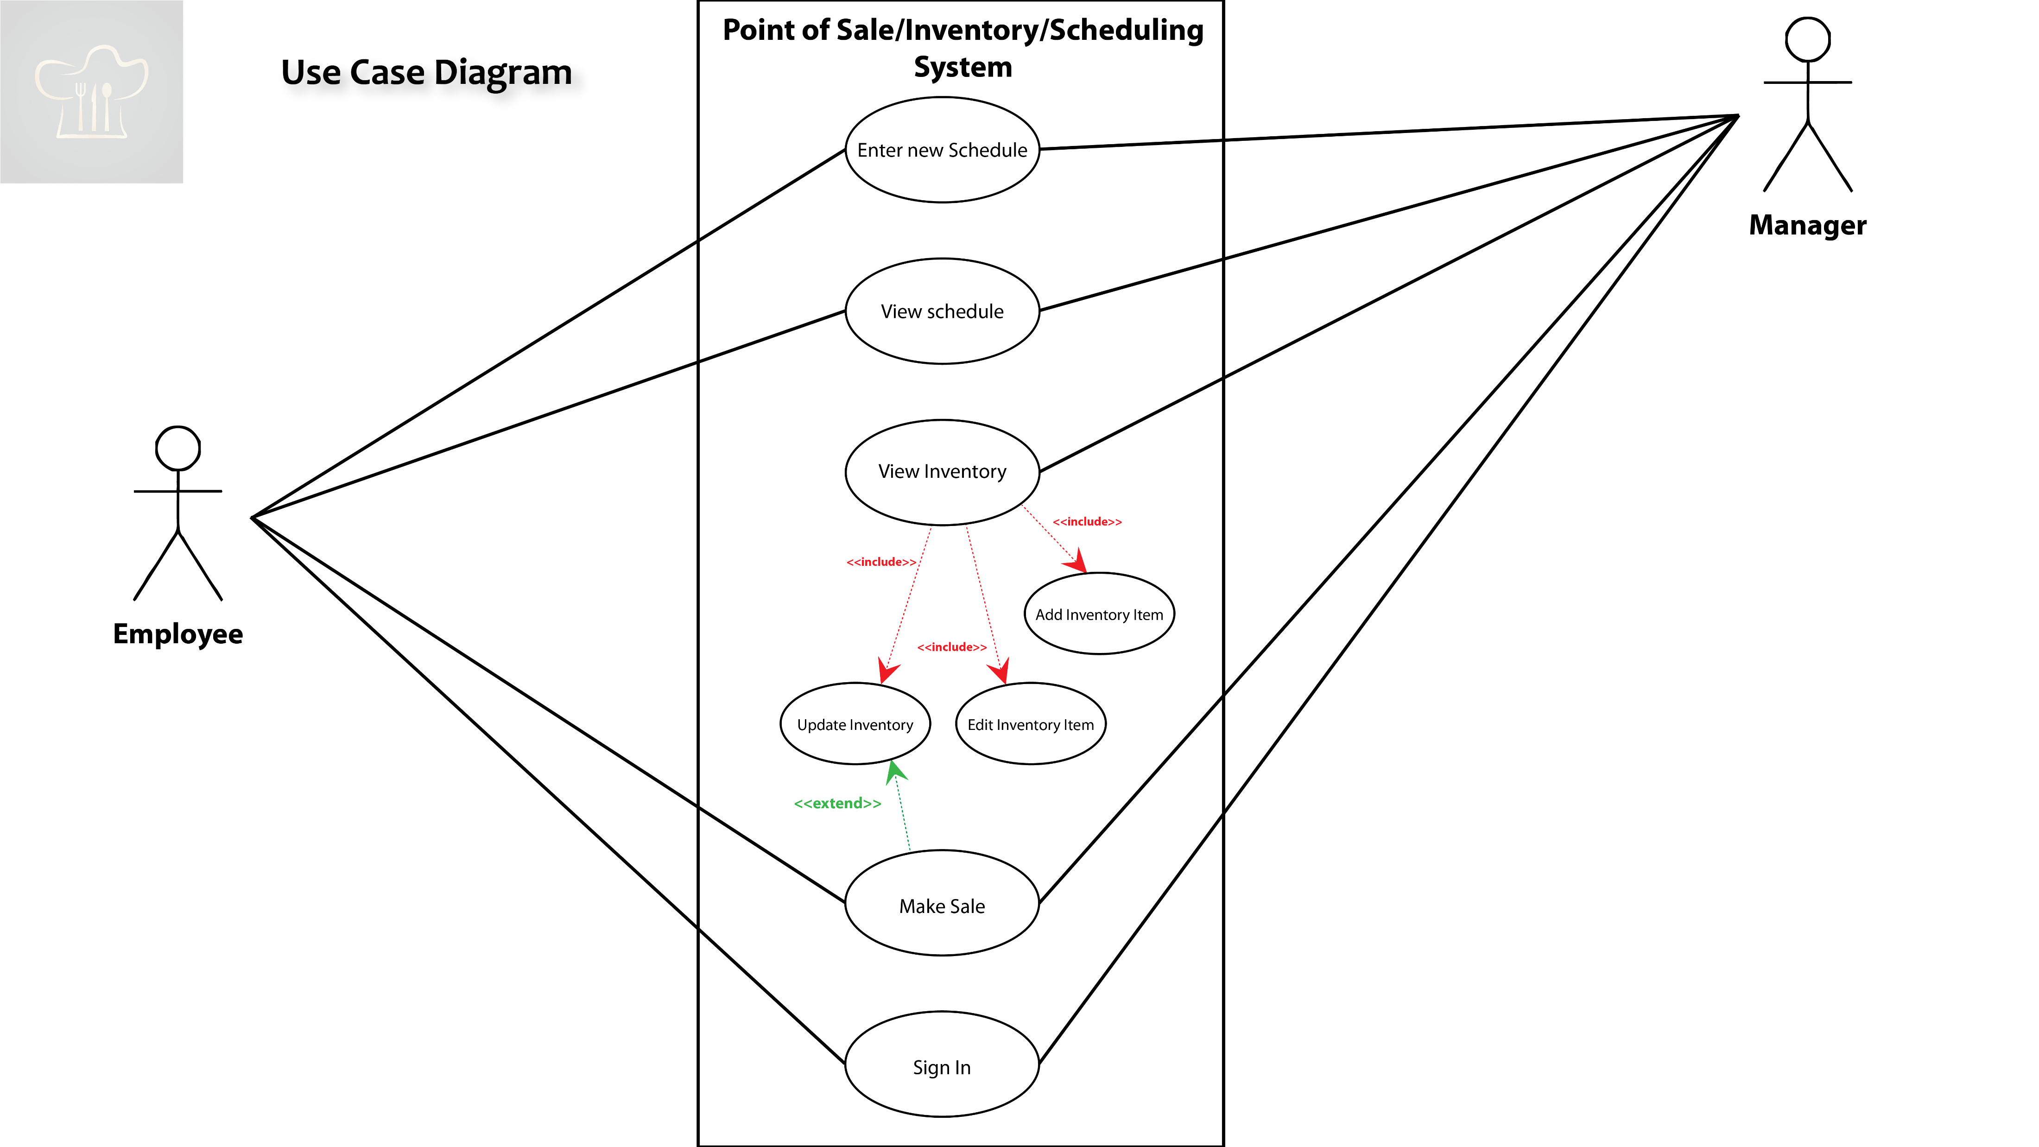

Slide 11
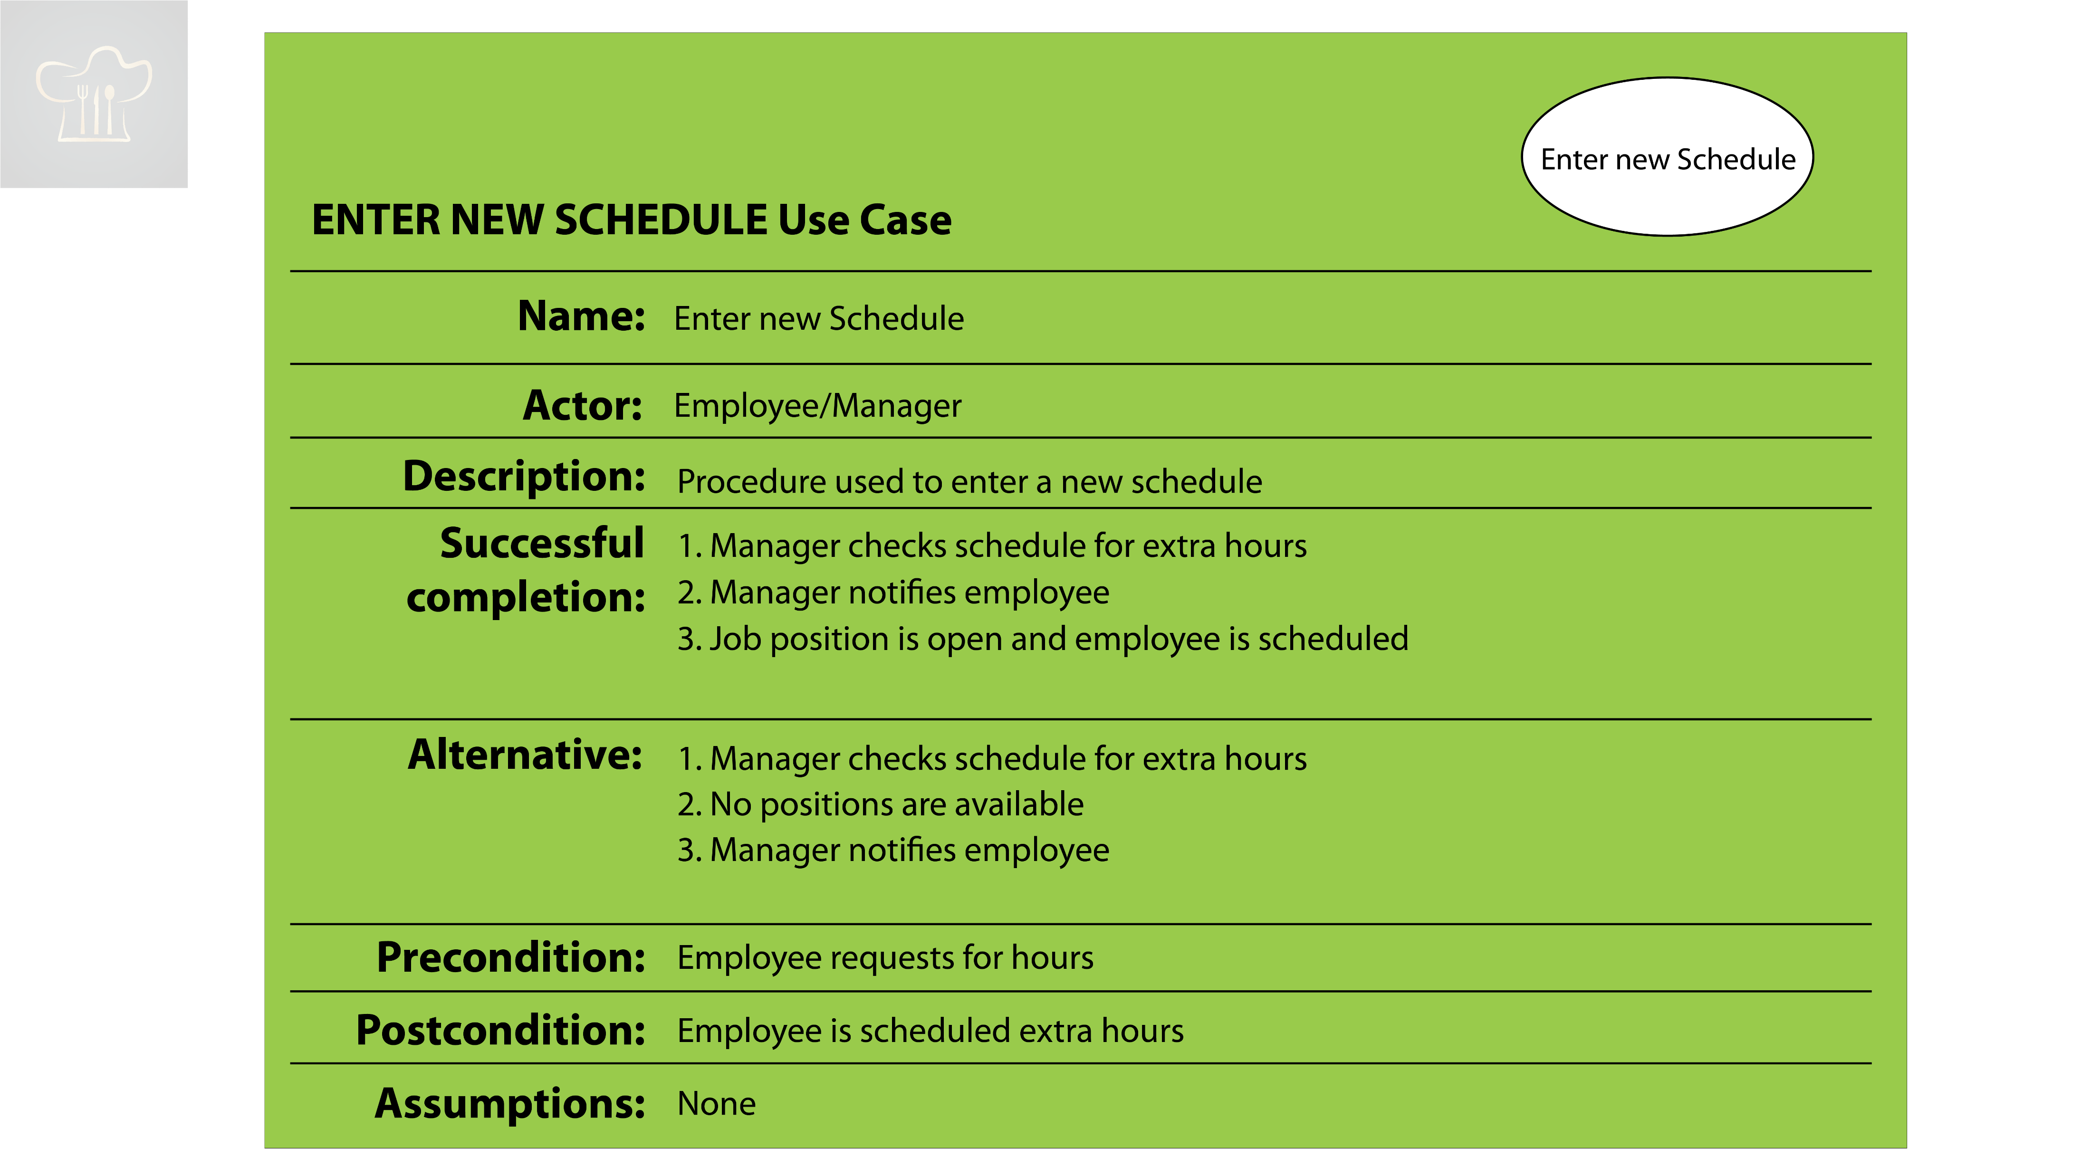

Slide 12
Database
Golden India Database were designed with the database concept and business functionality.
A well-designed database always performs better. Before designing a database, we always should consider the basic things:
The purpose of the database
The design whether it is fit with the plan or how it affects
The normalization rules that prevent mistakes in the database design
The Data integrity protection
The security requirements and user permissions
The backup and recovery
Restoring database
The roles and responsibilities

Slide 13
Relational Database Management System (RDBMS)
RDBMS stands for Relational Database Management System. It is structured in database tables, fields and records.
Each RDBMS table consists of database table rows, and each table row consists of one or more database table fields.
RDBMS store the data into collection of tables, provide relational operators to manipulate the data stored into the database tables.
Most RDBMS use SQL as database query language. The most popular RDBMS are MS SQL Server, DB2, Oracle and MySQL.

Slide 14
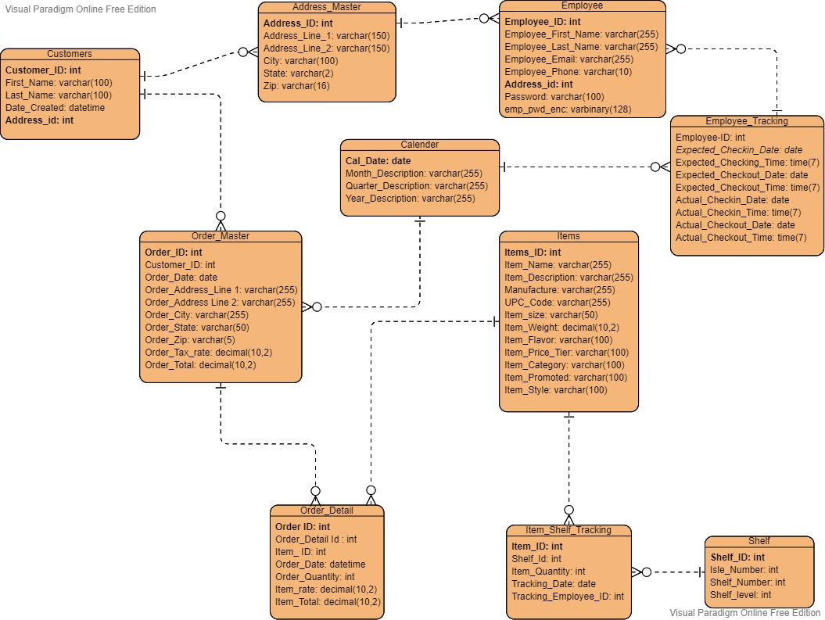
Database Entity-Relation Diagram (ERD)

Slide 15
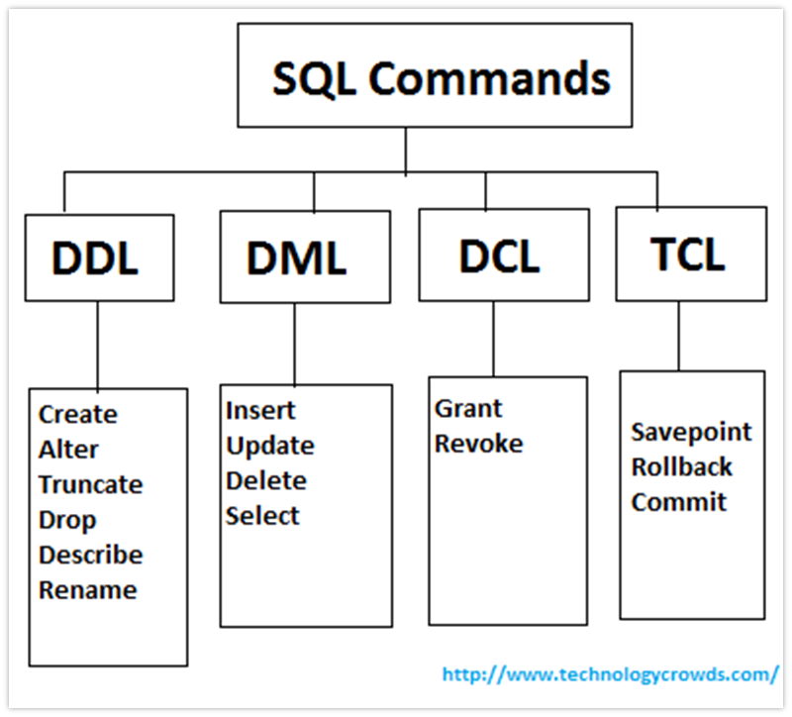
SQL – Querying the Database

Slide 16
Example – Employee Table
CREATE TABLE [dbo].[Employee]( [Employee_ID] [int] IDENTITY(1,1) NOT NULL,
[Employee_First_Name] [varchar](255) NOT NULL,
[Employee_Last_Name] [varchar](255) NOT NULL,
[Employee_Email] [varchar](255) NOT NULL,
[Address_id] [int] NULL,
[Employee_Phone] [varchar](10) NULL,
[Password] [varchar](100) NULL,
[emp_pwd_enc] [varbinary](128) NULL,
PRIMARY KEY CLUSTERED ( [Employee_ID] ASC
)WITH (PAD_INDEX = OFF, STATISTICS_NORECOMPUTE = OFF, IGNORE_DUP_KEY = OFF, ALLOW_ROW_LOCKS = ON, ALLOW_PAGE_LOCKS = ON) ON [PRIMARY] ) ON [PRIMARY]
GO
/****** Object: Table [dbo].[Employee_Tracking] Script Date: 4/22/2021 9:13:19 PM ******/
SET ANSI_NULLS ON
GO
SET QUOTED_IDENTIFIER ON

Slide 17
Data Integrity
Enforcing data integrity ensures the quality of the data in the database, and common forms of data integrity is referential integrity.
Referential integrity preserves the defined relationships between tables when records are entered or deleted.
In SQL Server, referential integrity is based on relationships between foreign keys and primary keys or between foreign keys and unique keys.
Referential integrity ensures that key values are consistent across tables. Such consistency requires that there be no references to nonexistent values and that if a key value changes, all references to it change consistently throughout the database.

Slide 18
Data Security
One of the functions of a database is to protect the data by preventing certain users from seeing or changing highly sensitive data and preventing all users from making costly mistakes.
For this reason, each application will use a separate user with specific permissions to only the data needed to provide a successful implementation.

Slide 19
Data Backup and Recovery
Full Backup
Complete a full backup up the database right up to the point where the database finishes.
Backup all tables, indexes, system tables and the database object in those tables.
Differential Backup
Creates a backup of the changes made to the database since the last full back up
It does not keep track of all transaction, so it does not provide the ability to restore to a point in time.
Transaction log backup
It keeps log of each transaction and provide ability to roll forward or roll back to a specific point.
When the transaction log is backed up the log is truncated.
File groups
It allows user to place table, indexes and other database object into specific database file.
It can be backed up and restores individually or groups.
Useful when time restrain prevent full backups.

Slide 20
Tableau Tool for Data Analytics
Why Tableau?
It is a modern business intelligence platform, and market leading choice.
Compare to other Business Intelligence tools, Tableau creates rich visualization in just a minutes, and perform complex task with simple drag-and-drop functionality.
Tableau can handle millions of rows of data, without impacting the performance of the dashboard.
Tableau can easily be integrated with scripting language, and also with R and Python. Thus it helps in amplifying data with visual analytics
Benefits of Tableau
Tableau allows to build easily and rapidly dashboards
Efficient broadcasting. Think of subscription option. Also available on iPhone Pro.
Easy to change / create a report once the data are prepared
Modern design

Slide 21
Tableau Tool for Data Analytics
Developer Tools
It is used for development such as the creation of dashboard, charts, and reports generation.
The Tableau Desktop and Tableau Public comes under this category.
Sharing Tools
It is used for sharing the visualization, reports, dashboard that were created with clients and managers.
The products come under this category are Tableau online, Server and Reader.

Slide 22
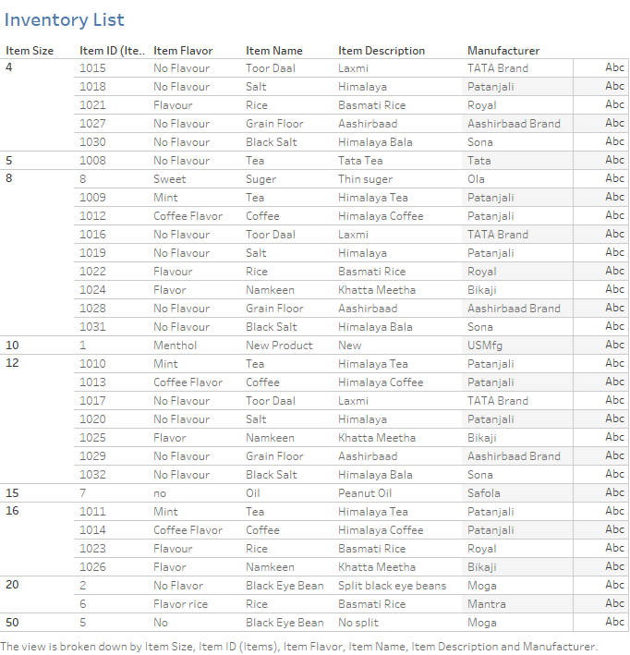
Reports

Slide 23
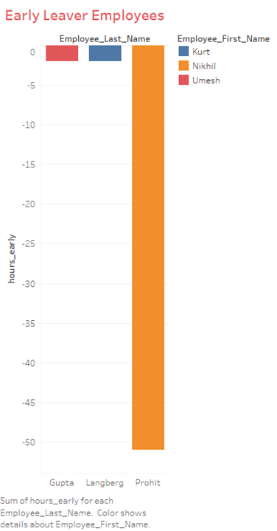
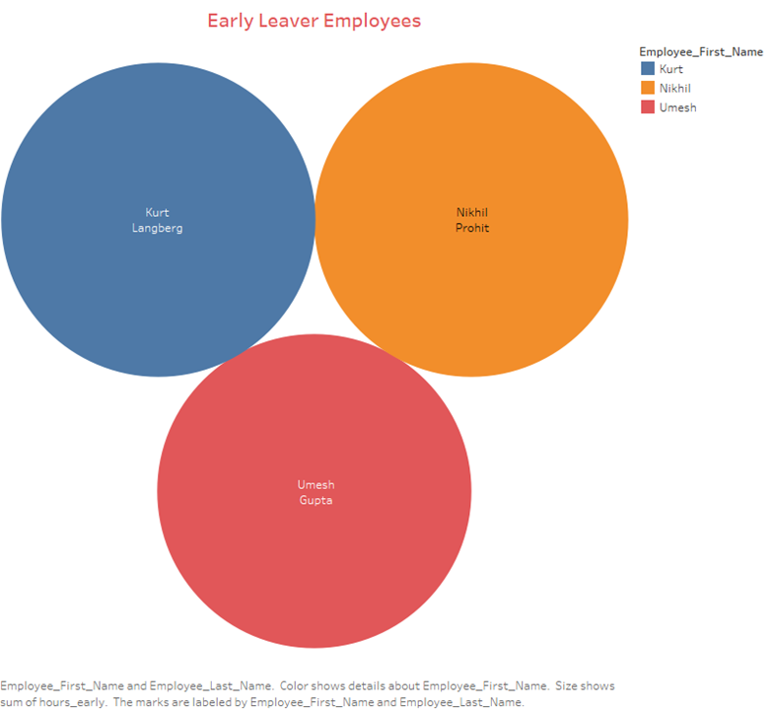
Reports

Slide 24
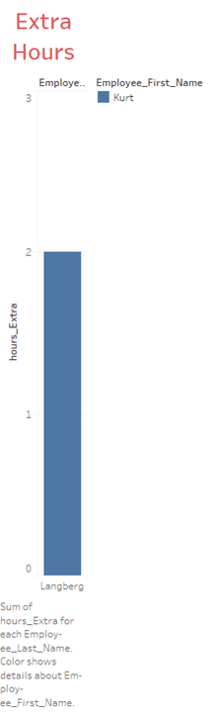
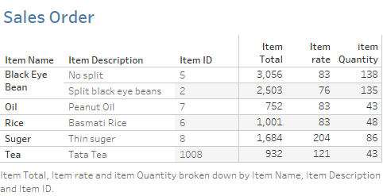
Reports

Slide 25
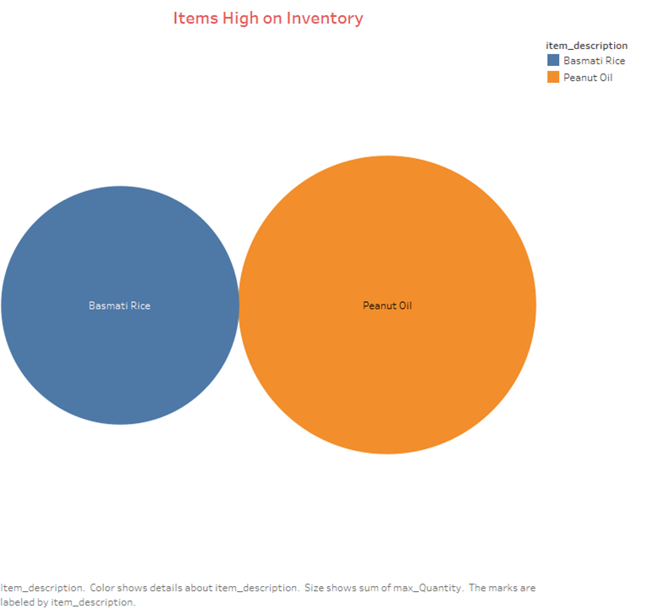
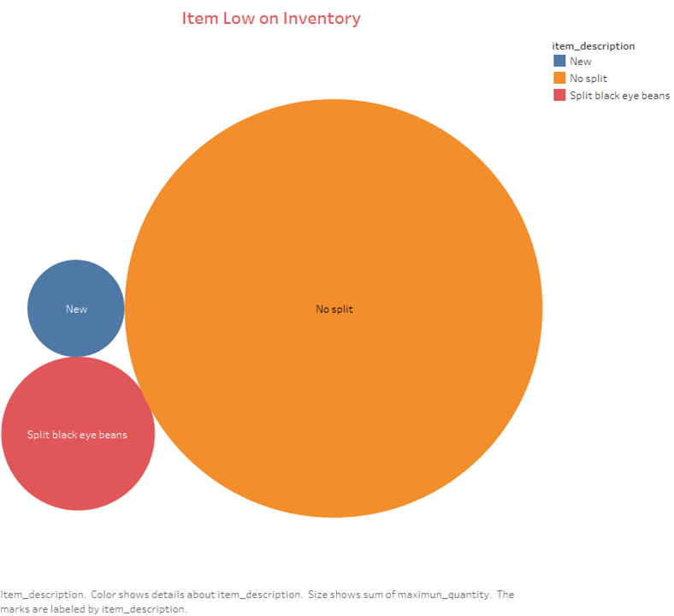
Reports

Slide 26
Tableau data management
Tableau Prep Conductor
It is being used for sharing the work within organization, and it does automate the data process, also create a centrally managed and governed data prep process.
Tableau Catalog
It provide a complete overview of all data, and it is being used for statistics, origin and the impact analysis and relationship between the data and in our analysis. It provide more value for all Tableau users by giving more visibility, more confidence in the data is possible.

Slide 27
Tableau Reports Back and Restore
Usually, Tableau Server administrator does perform regular database maintenance, including monitor disk usage on the server, clean up unnecessary files to free up space on the server, and back up Tableau server and its data.
The Tableau service manager (TSM) command is used for backing up and restore database, which include data extract files, as well as Tableau server’s own PostgreSQL database
The PostgreSQL database store all workbook and user metadata, server configuration data.

Slide 28

Questions?

